Slide 1
MARKETING ANALYTICS I
SESSION 6:
Multinomial Choice Models:
In Class Exercise
Professor Sonnier
Texas MSBA Program
Fall 2022

Slide 2
CHOICE BASED CONJOINT DATA
Choice Among Multiple Alternatives
Up to now we have considered only binomial choice
We considered profiles and a response to the profile
What if we want to consider “Choose profile j” from a set of j=1,…,J profiles?
How to set up experiments to collect data?
How to analyze the data?

Slide 3
CHOICE BASED CONJOINT DATA
Choice Among Multiple Alternatives
How to set up experiments to collect data?
How to analyze the data?

Slide 4
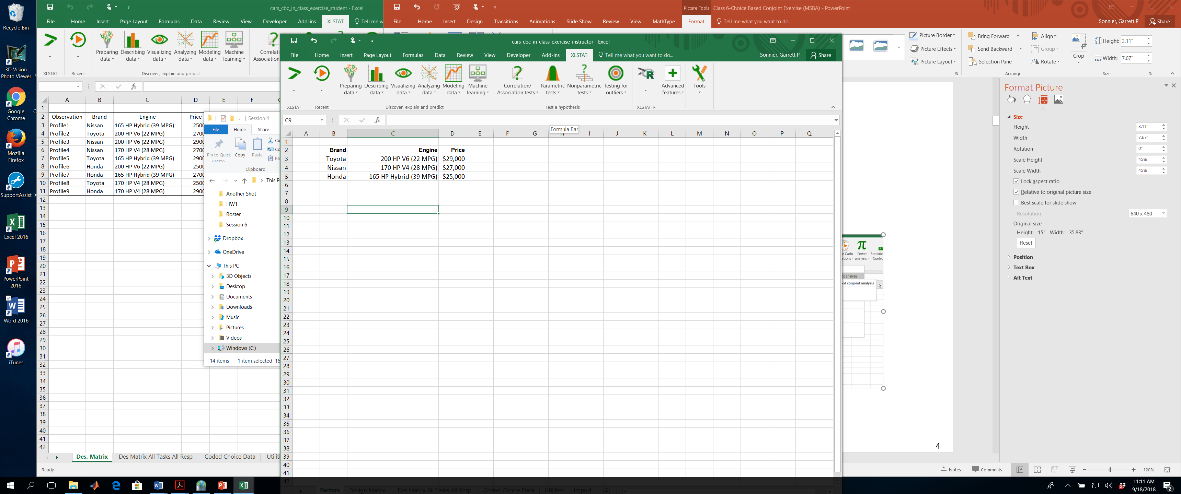
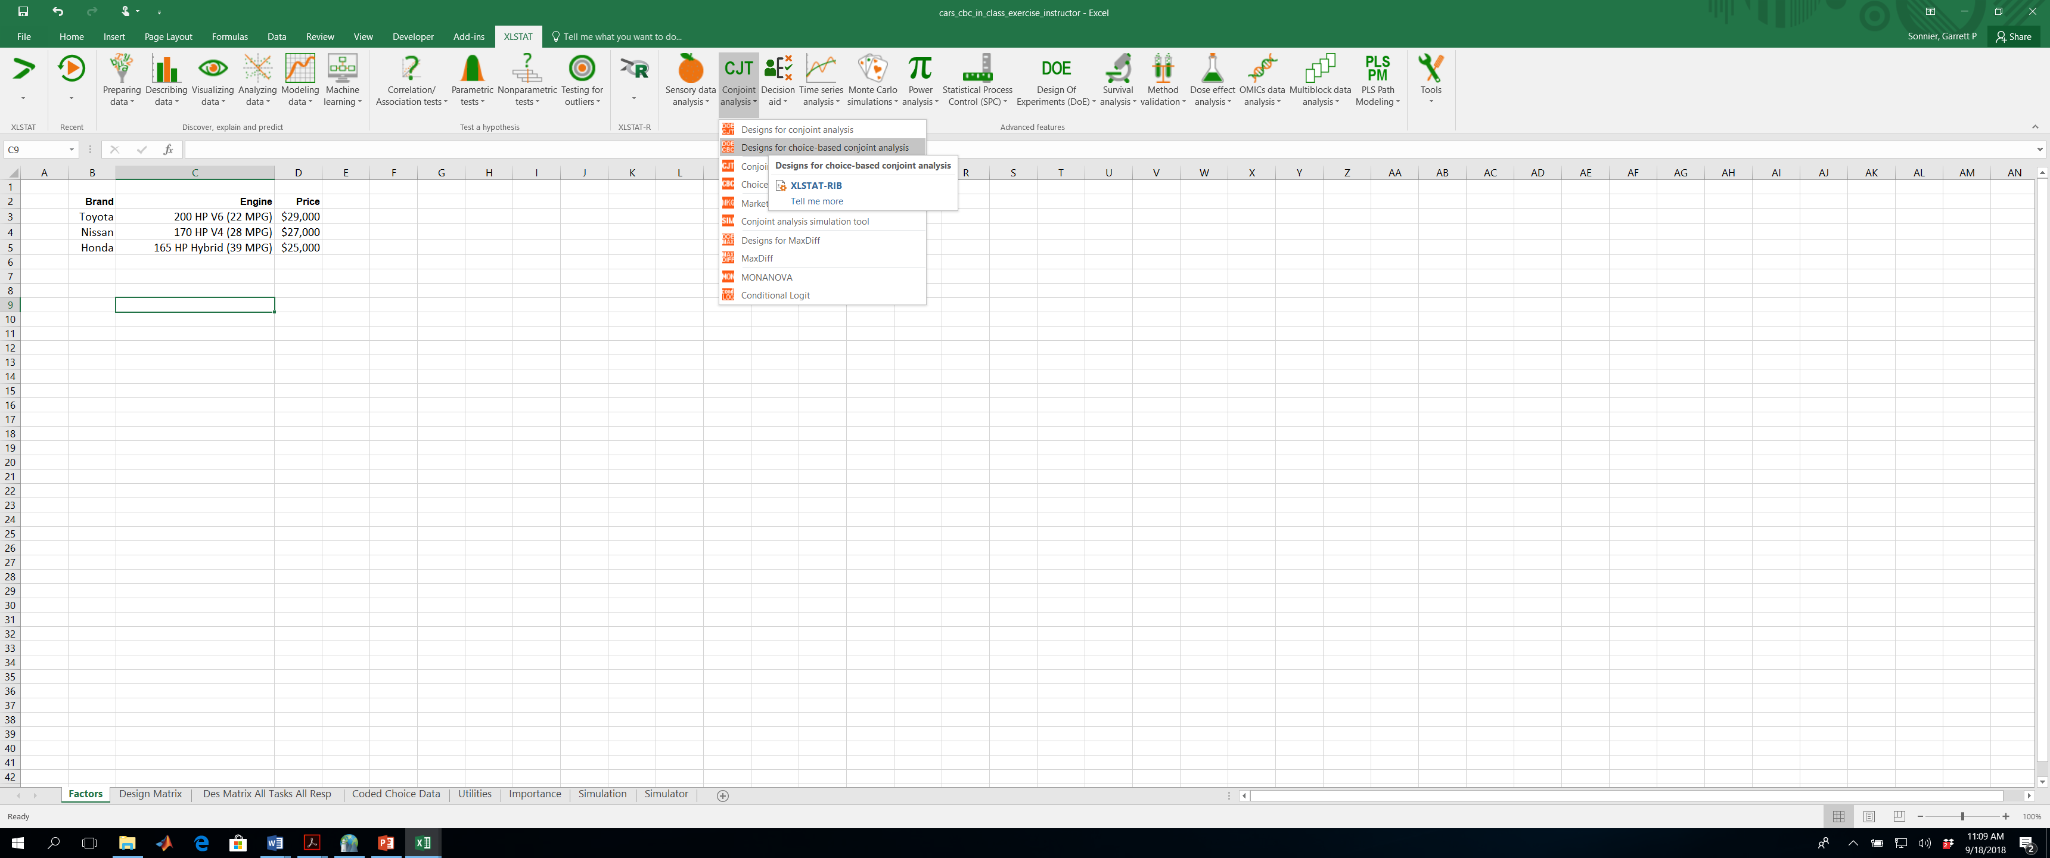
CHOICE BASED CONJOINT DATA
Designing Choice Experiments

Slide 5
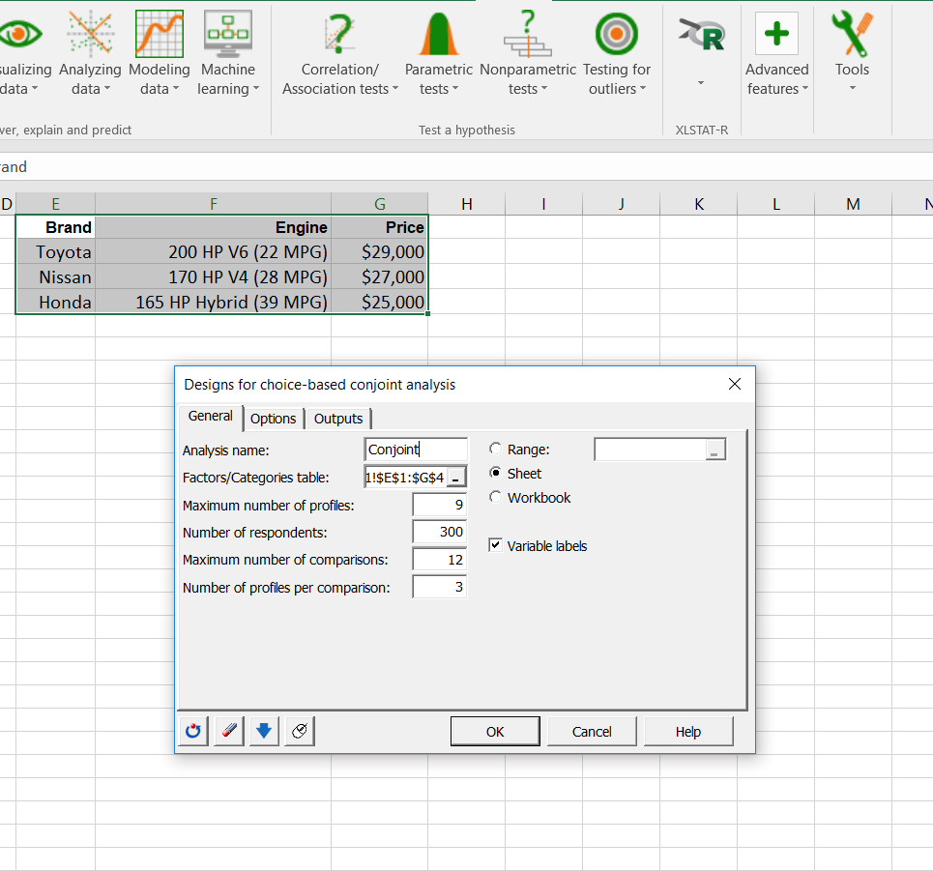
CHOICE BASED CONJOINT DATA
Designing Choice Experiments

Slide 6
CHOICE BASED CONJOINT DATA
Study Design

Slide 7
CHOICE BASED CONJOINT DATA
Study Design
Profiles
Choice Sets

Slide 8
CHOICE BASED CONJOINT DATA
Example Task for Respondent
Profiles
Choice Sets
Respondent Task

Slide 9
CHOICE BASED CONJOINT DATA
Coded Design Matrix for One Respondent
Profiles
Choice Sets

Slide 10
CHOICE BASED CONJOINT DATA
Coded Design Matrix for One Respondent
What about different forms of utility?

Slide 11
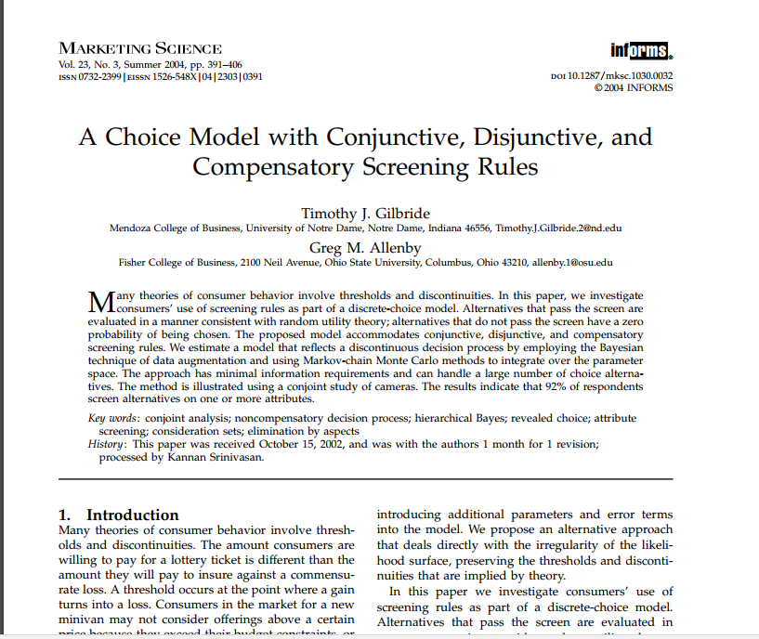
CHOICE BASED CONJOINT DATA
If You Want to Really Complicate Matters…
LINK

Slide 12
CHOICE BASED CONJOINT DATA
Coded Design Matrix and Choices for One Respondent
Design Matrix (the X data)
Coded Choice Data (the y data)

Slide 13
CHOICE BASED CONJOINT DATA
Your Mission

Slide 14
DISCRETE CHOICE
Steps to Perform ML Estimation of Logit Model
Take initial guess at a and b (zero works!)
Compute utilities
Exponentiate utilities
Compute choice Probabilities
Compute likelihood of each observation
Take logs
Sum log likelihood
Let computer search to find a and b to maximize log-likelihood

Slide 15
CHOICE BASED CONJOINT DATA
Utility for i=1, t=1 (First person, first task)
Initial guess for parameters
X data for first individual (all tasks, all alternatives)
Utilities for first individual, task 1, task 2,…

Slide 16
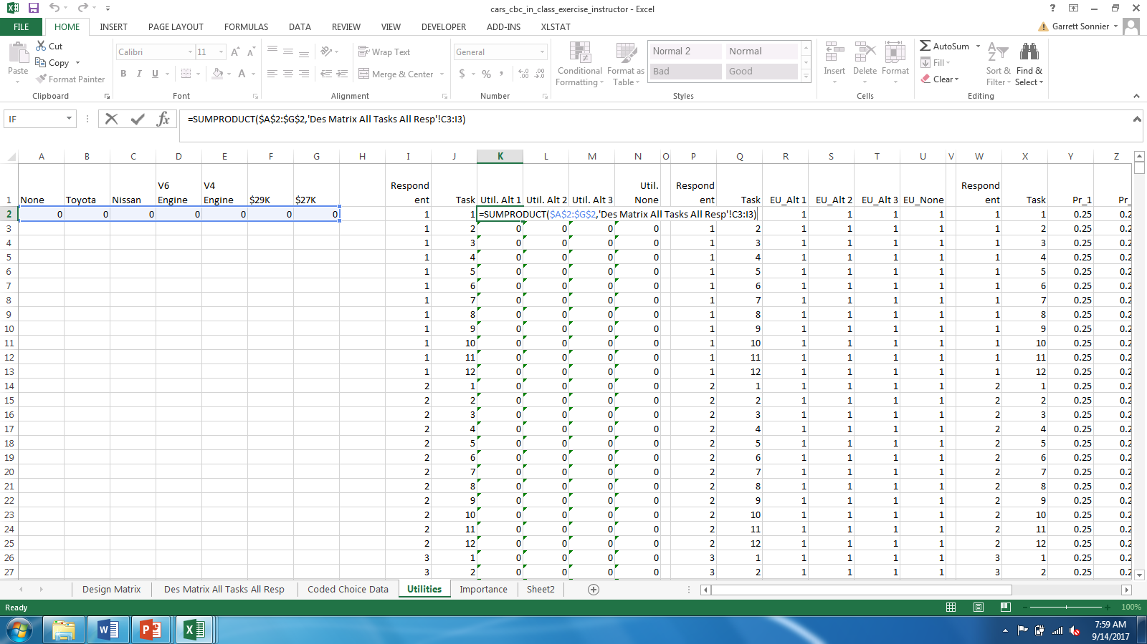
CHOICE BASED CONJOINT DATA
Utility Calculations: i=1, j=1,t=1

Slide 17
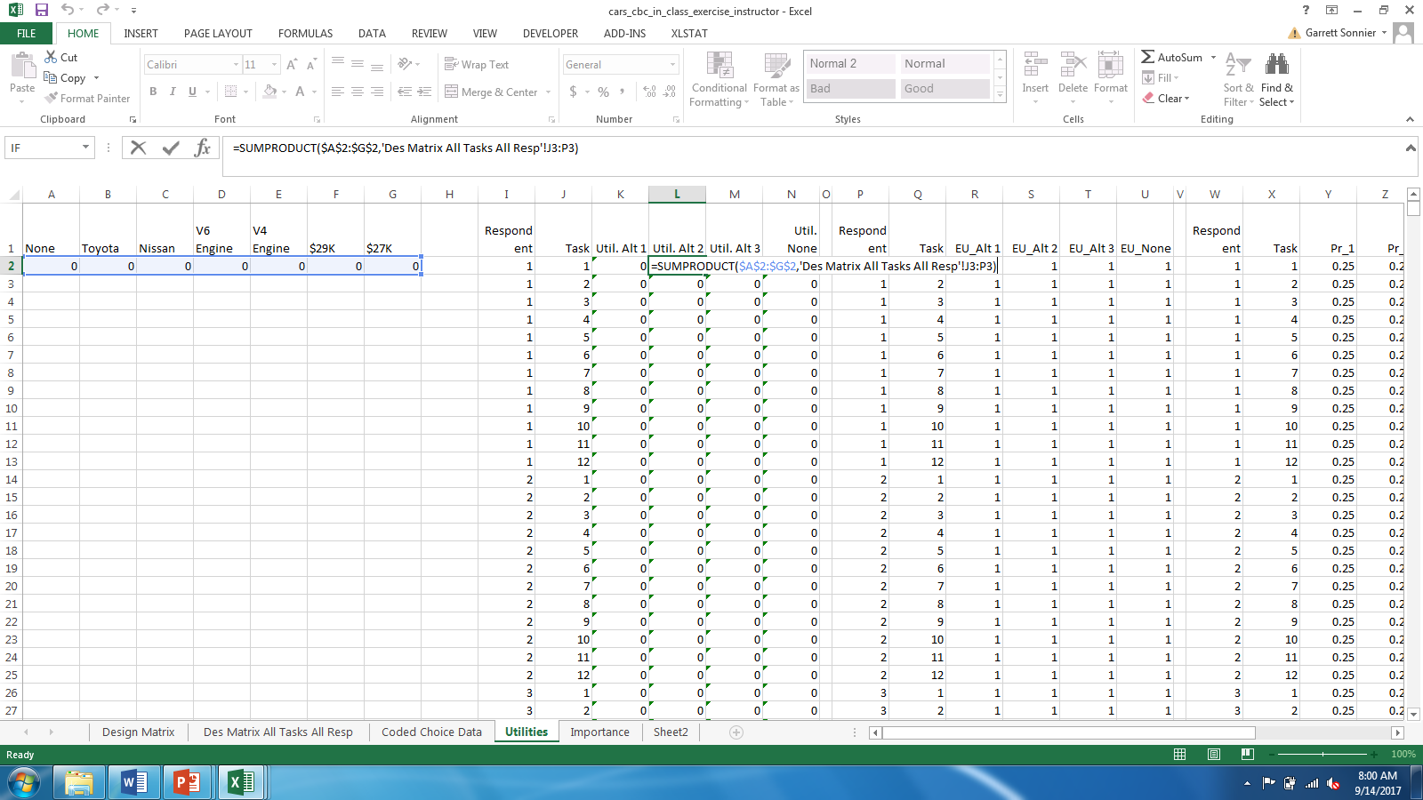
CHOICE BASED CONJOINT DATA
Utility Calculations: i=1, j=2,t=1

Slide 18

CHOICE BASED CONJOINT DATA
Utility Calculations: i=1, j=3,t=1

Slide 19
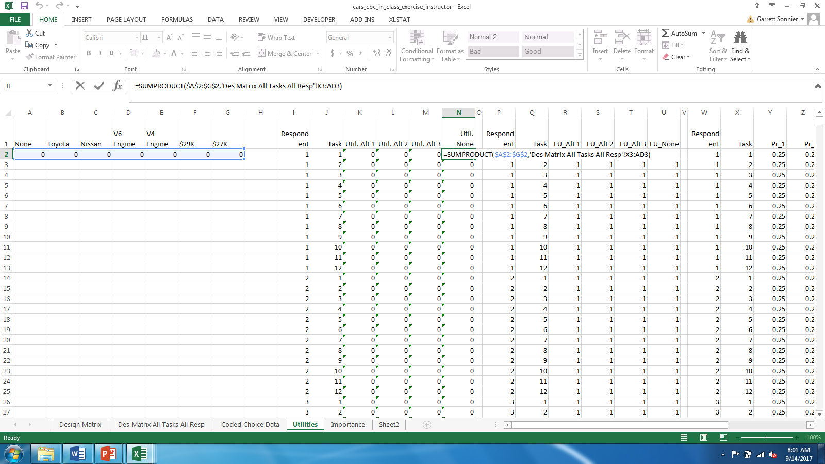
CHOICE BASED CONJOINT DATA
Utility Calculations: i=1, j=4,t=1

Slide 20
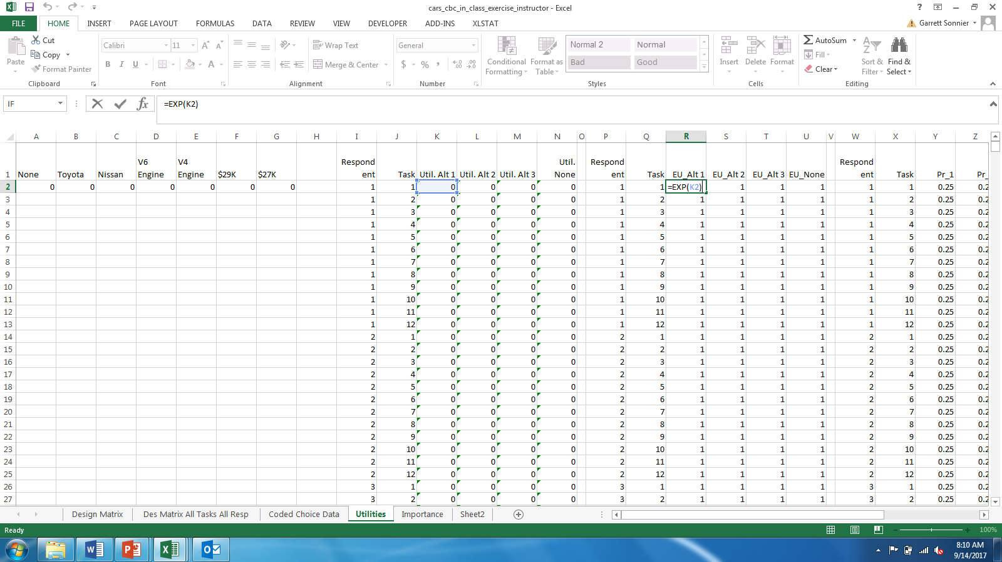
CHOICE BASED CONJOINT DATA
Exponentiate the Utilities (example for j=1)

Slide 21
CHOICE BASED CONJOINT DATA
Compute the Probabilities

Slide 22
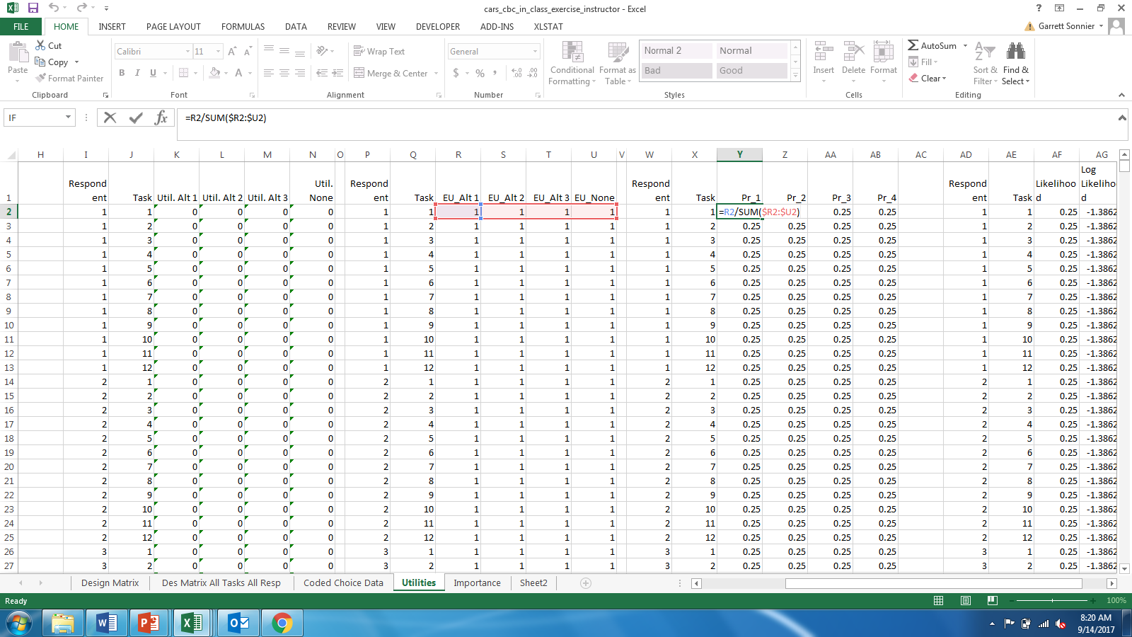
CHOICE BASED CONJOINT DATA
Compute the Probabilities (example for j=1)

Slide 23
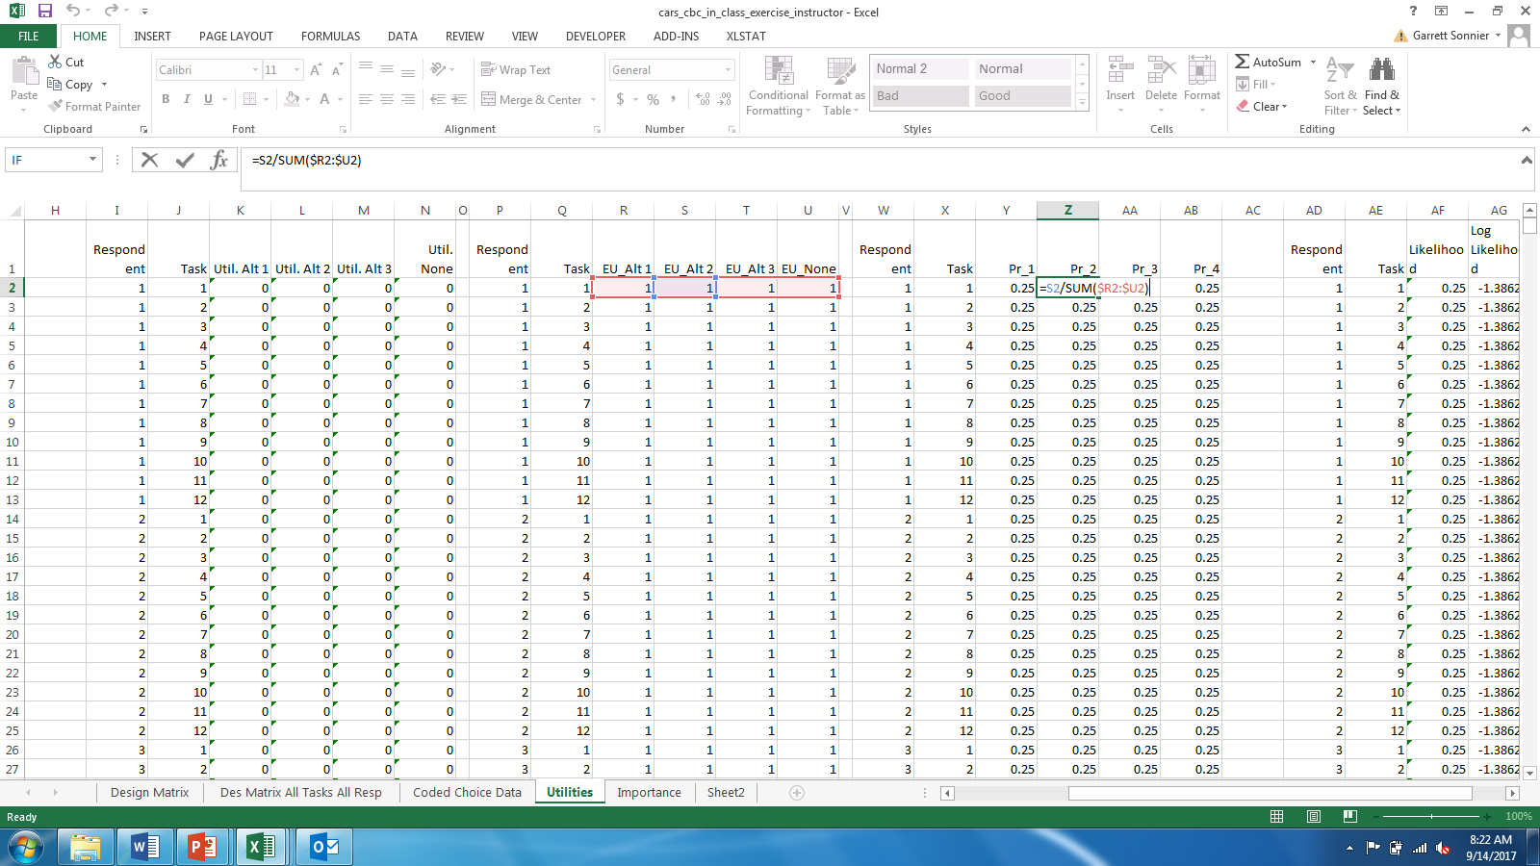
CHOICE BASED CONJOINT DATA
Compute the Probabilities (example for j=2)

Slide 24
CHOICE BASED CONJOINT DATA
Compute the Likelihood of the Observed Choice Data
Coded Choice Data (the y data)
Probabilities

Slide 25
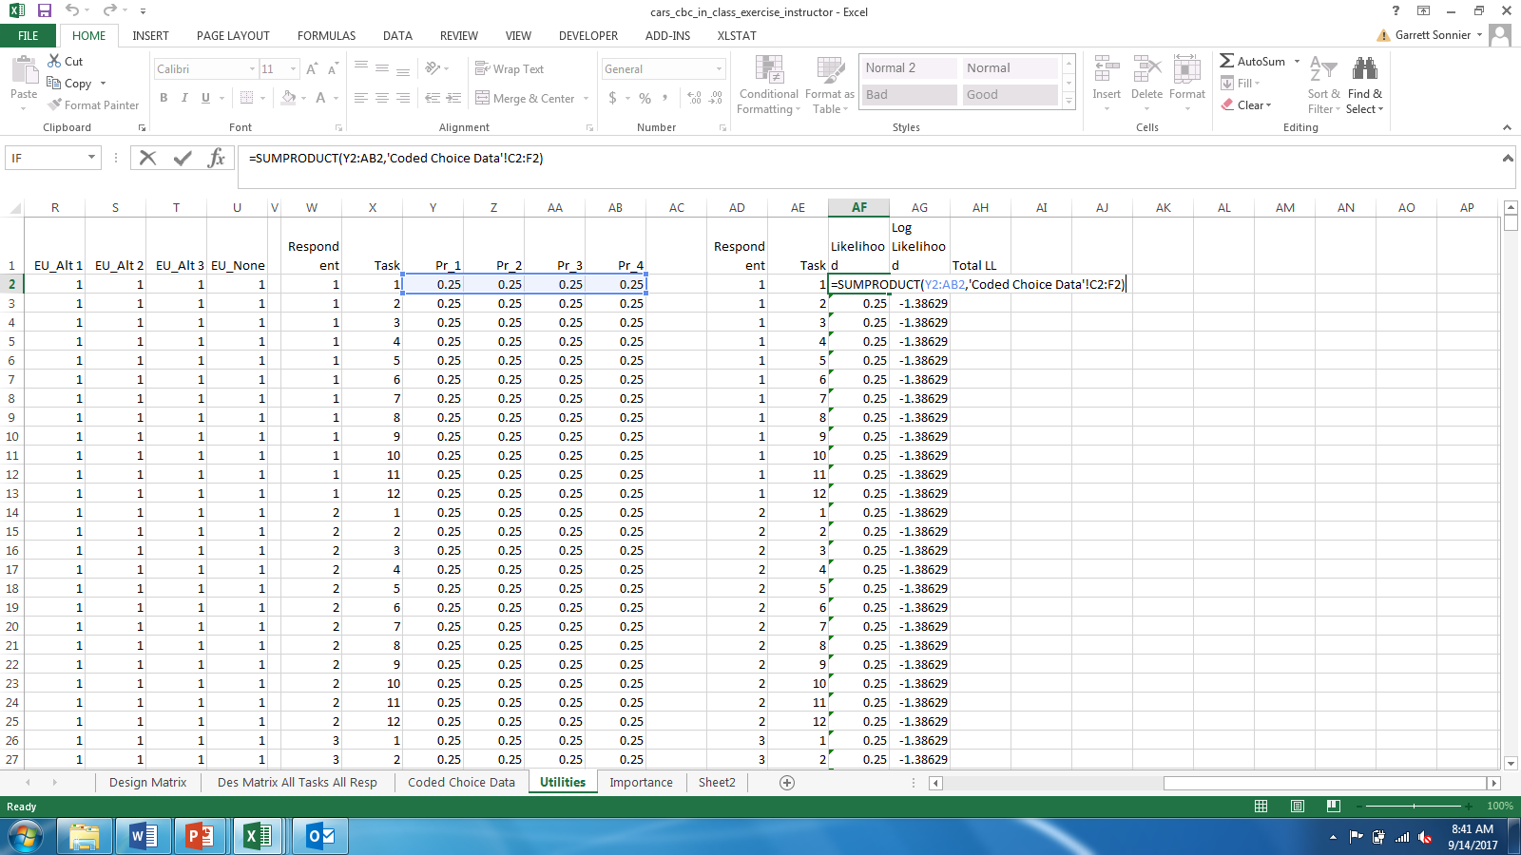
CHOICE BASED CONJOINT DATA
Compute the Likelihood of the Observed Choice Data

Slide 26
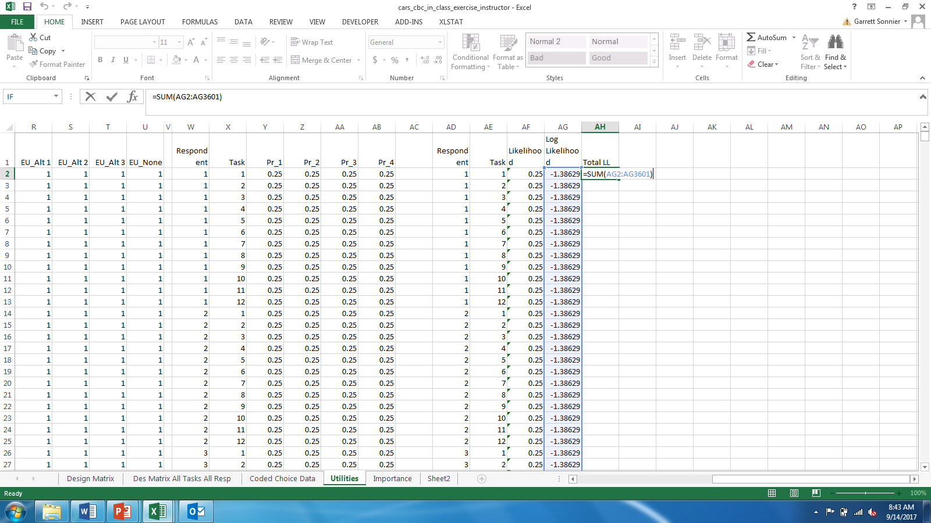
CHOICE BASED CONJOINT DATA
Compute the Total Log Likelihood

Slide 27
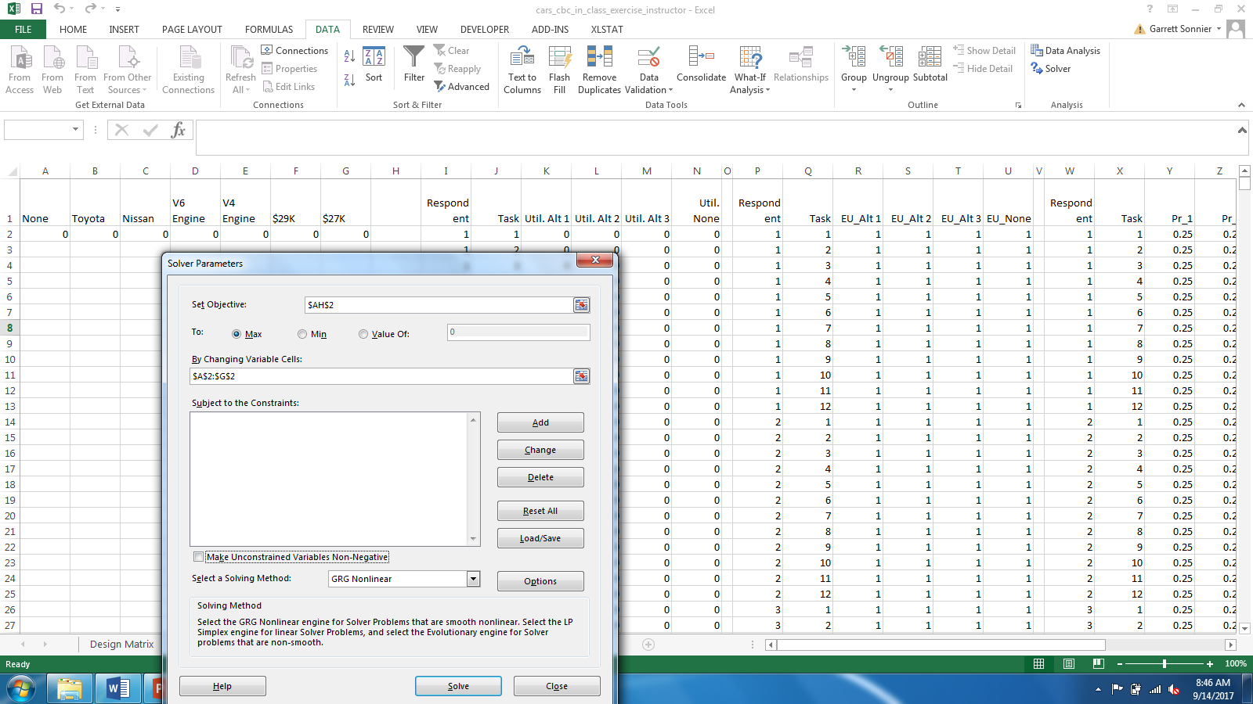
CHOICE BASED CONJOINT DATA
Compute the Likelihood of the Observed Choice Data

Slide 28
CHOICE BASED CONJOINT DATA
Results!

Slide 29
CHOICE BASED CONJOINT DATA
In XLSTAT

Slide 30
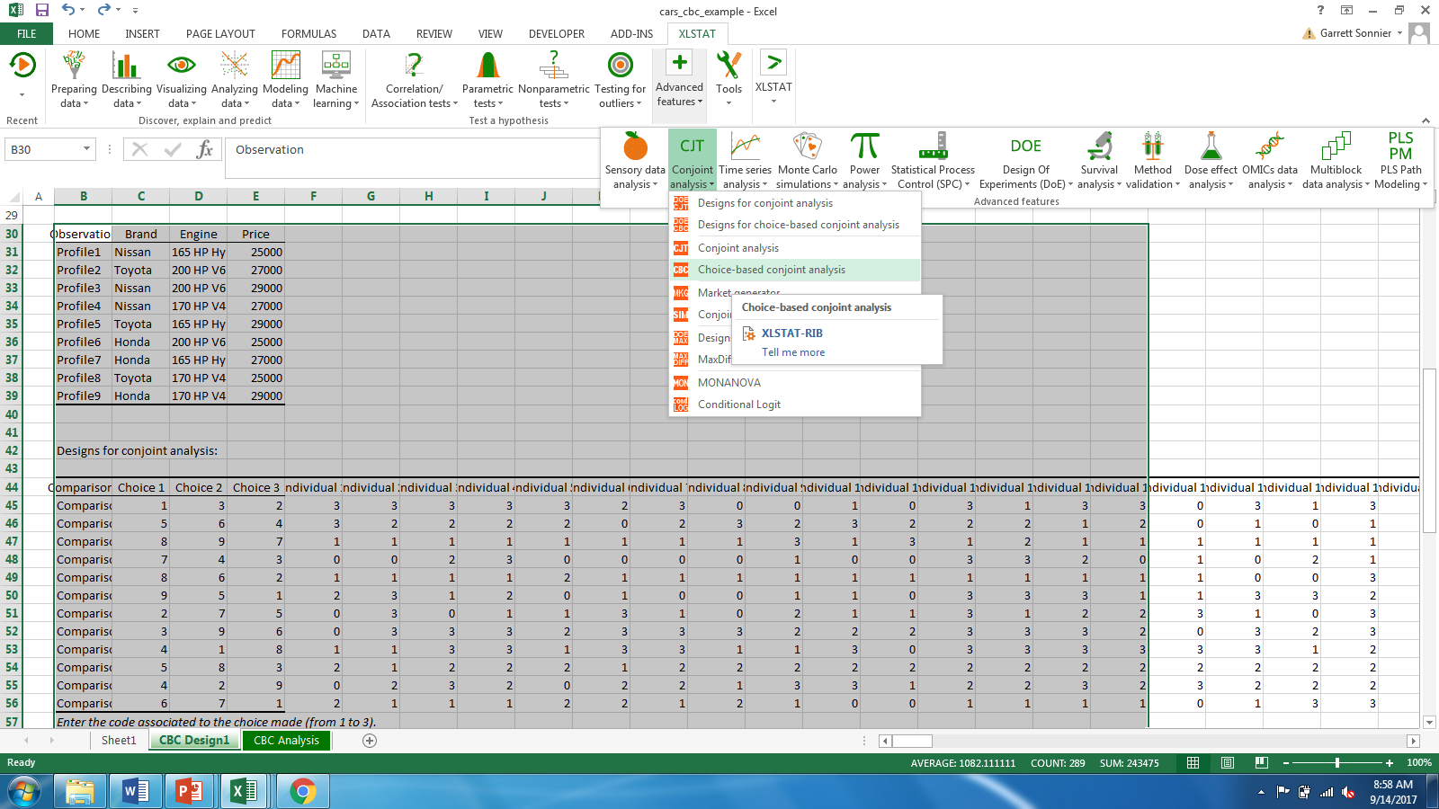
CHOICE BASED CONJOINT DATA
In XLSTAT

Slide 31
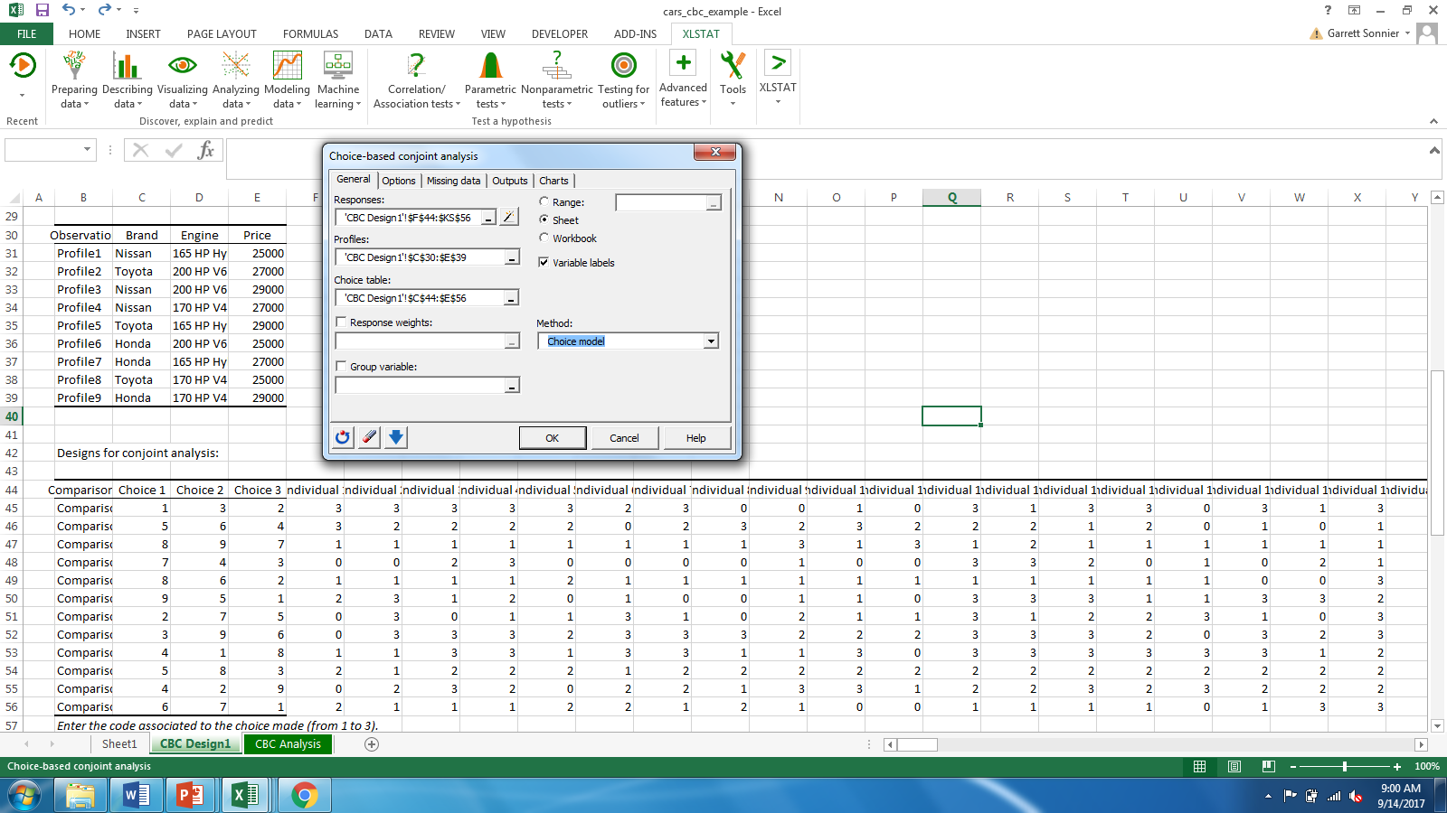
CHOICE BASED CONJOINT DATA
In XLSTAT

Slide 32
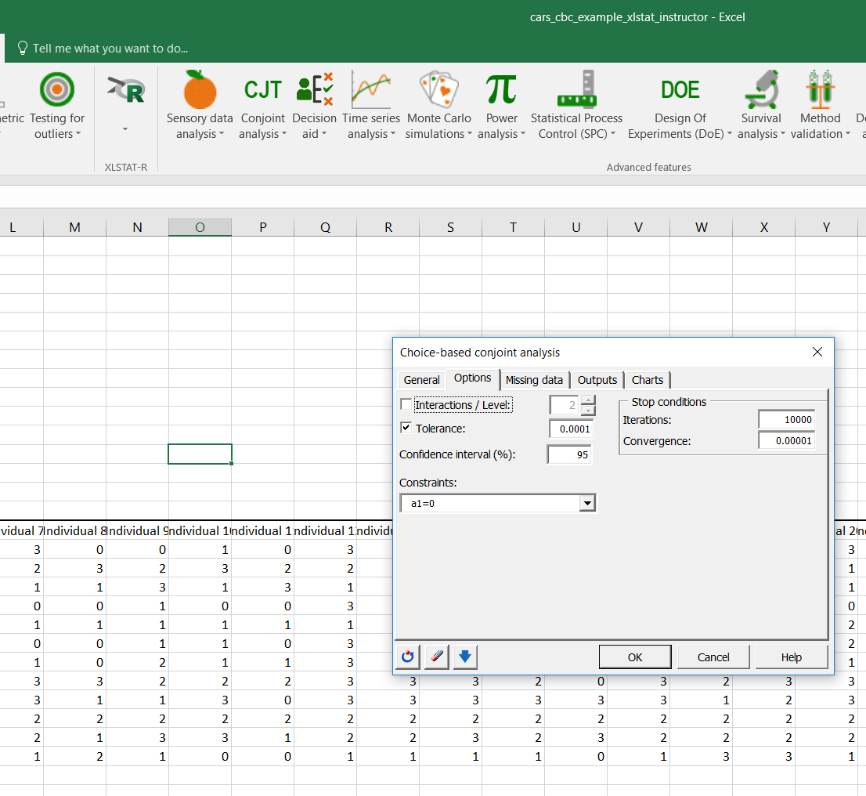
CHOICE BASED CONJOINT DATA
In XLSTAT

Slide 33
CHOICE BASED CONJOINT DATA
Everything’s Copacetic!

Slide 34
CHOICE BASED CONJOINT DATA
Attribute Importance

Slide 35
CHOICE BASED CONJOINT DATA
Simulated Market

Slide 36
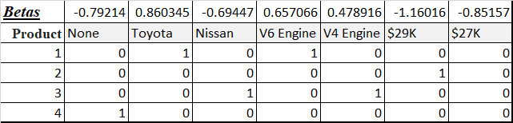
CHOICE BASED CONJOINT DATA
Simulated Market
Compute predicted utilities using betas
Use Logit Rule to predict shares

Slide 37

CHOICE BASED CONJOINT DATA
Simulated Market
Use SUMPRODUCT to compute utility

Slide 38
CHOICE BASED CONJOINT DATA
The Logit Rule for Predicted Share

Slide 39

CHOICE BASED CONJOINT DATA
The Logit Rule for Predicted Market Share
First exponentiate the utilities

Slide 40

CHOICE BASED CONJOINT DATA
The Logit Rule for Predicted Market Share
Use the exponentiated utilities to compute the shares

Slide 41
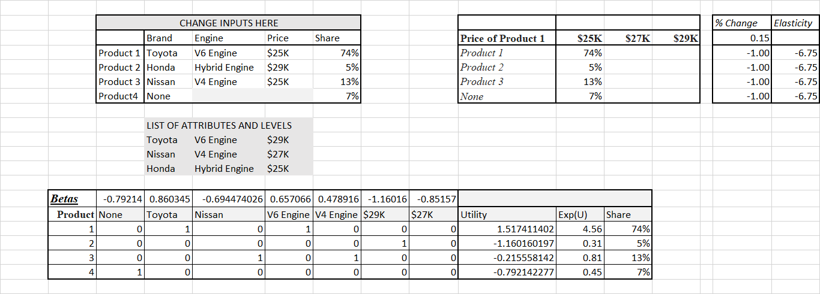
CHOICE BASED CONJOINT DATA
The Logit Rule for Predicted Market Share

Slide 42
CHOICE BASED CONJOINT DATA
The Logit Rule for Predicted Market Share

Slide 43
MARKETING ANALYTICS
Key Concepts for Class Exercise
We generalized binary choice models to multinomial choice models
We are able to generate estimates of the probability of buying conditional on observed product attributes
Unlike linear conjoint we have only an aggregate model to predict probability and market share
Aggregate model can be used to do market share analysis
Model yields counterintuitive patters of cross price effects
We will want to investigate this more next week when we look at preference segmentation

